Slide 1
01/13
CHEAPER EXCHANGE OF INFORMATION VIA WIRELESS TECHNOLOGY
Supervisors:
Dr. Petronilla Muriithi
Prof. Waweru Mwangi
KAIRU JOSHUA WAMBUGU – CS281-0720/2011

Slide 2
02/13
What Do We Expect?
The objectives
(A very abstracted) explanation
Implementation and Results
Limitations and recommendations

Slide 3
03/13
The Objectives
Two smartphones should be able to connect with each other via wireless
without the aid of an infrastructure device such as a wireless router or a
wireless hotspot.
The aforementioned smartphones should then be able to send and receive data – initially audio data – between themselves.

Slide 4
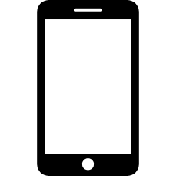


04/13
(A Very Abstracted) Explanation
WITHOUT A THIRD PARTY!

Slide 5
05/13
Implementation
Language: Android, Java, XML
IDE: Android Studio
Devices:
Huawei Ideos U8150 (Android 2.2),
Samsung GT-S6790 (Android 4.1.2),
InnJoo Fire Plus (Android 4.4.2)
Screenshots next

Slide 6
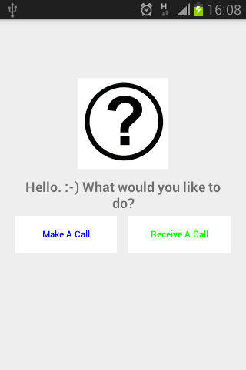

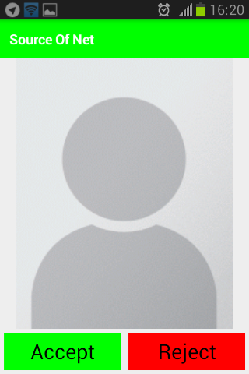
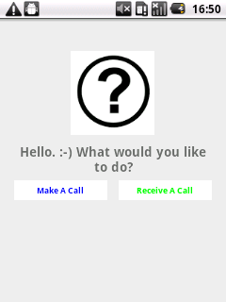
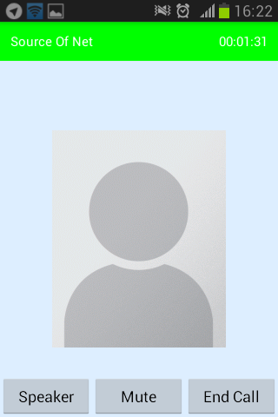
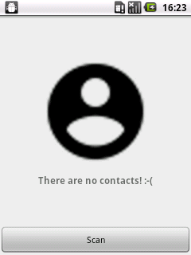
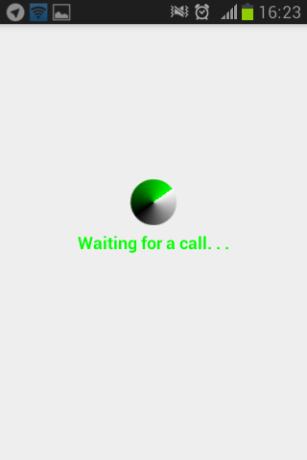
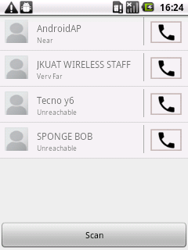
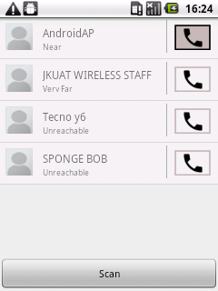
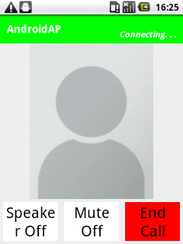
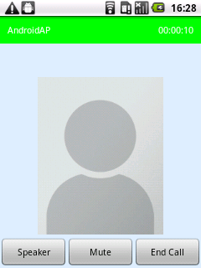
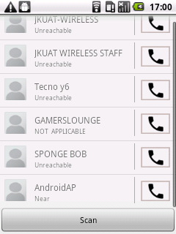
06/13

Slide 7
07/13
Results(1)
Devices got connected to each other
No data was lost with increased distance
No data was lost with increased recording time

Slide 8
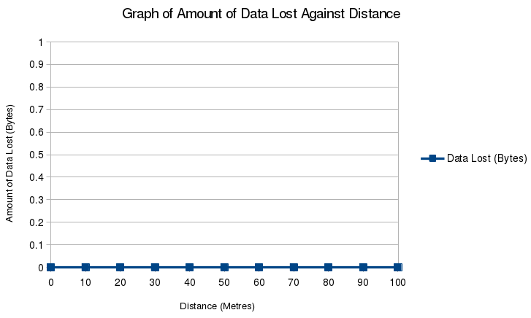
08/13
Results(2)

Slide 9
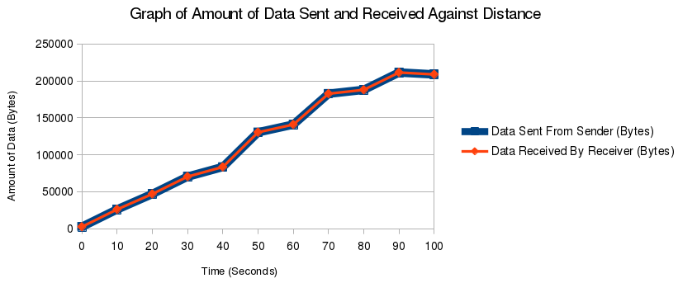
09/13
Results(3)

Slide 10
10/13
Limitations
Technological limitations.
Choppy sound.
Manual setup.

Slide 11
11/13
Recommendations
WiFi Direct.
Streaming.

Slide 12
12/13
Did We Get What We Expected?
Project objectives were met
We saw a (very abstracted) explanation
Execution and its results
Limits and future work

Slide 13


13/13
THE FINAL END
Thank you for watching

